Slide 1
Serverless On Edge Lean-Openwhisk
Σταυρακάκης Κωνσταντίνος
Kostantinosst23@gmail.com
https://github.com/razkey23/Serverless-On-Edge
Notes:
We designed this template so that each member of the project team has a set of slides with its own theme. Members, here’s how you add a new slide to just your set:
Mark where you want to add the slide: Select an existing one in the Thumbnails pane, click the New Slide button, then choose a layout. The new slide gets the same theme as the other slides in your set.
Careful! Don’t annoy your fellow presenters by accidentally changing their themes. That can happen if you choose a different theme from the Design tab, which changes all of the slides in the presentation to that look.

Slide 2
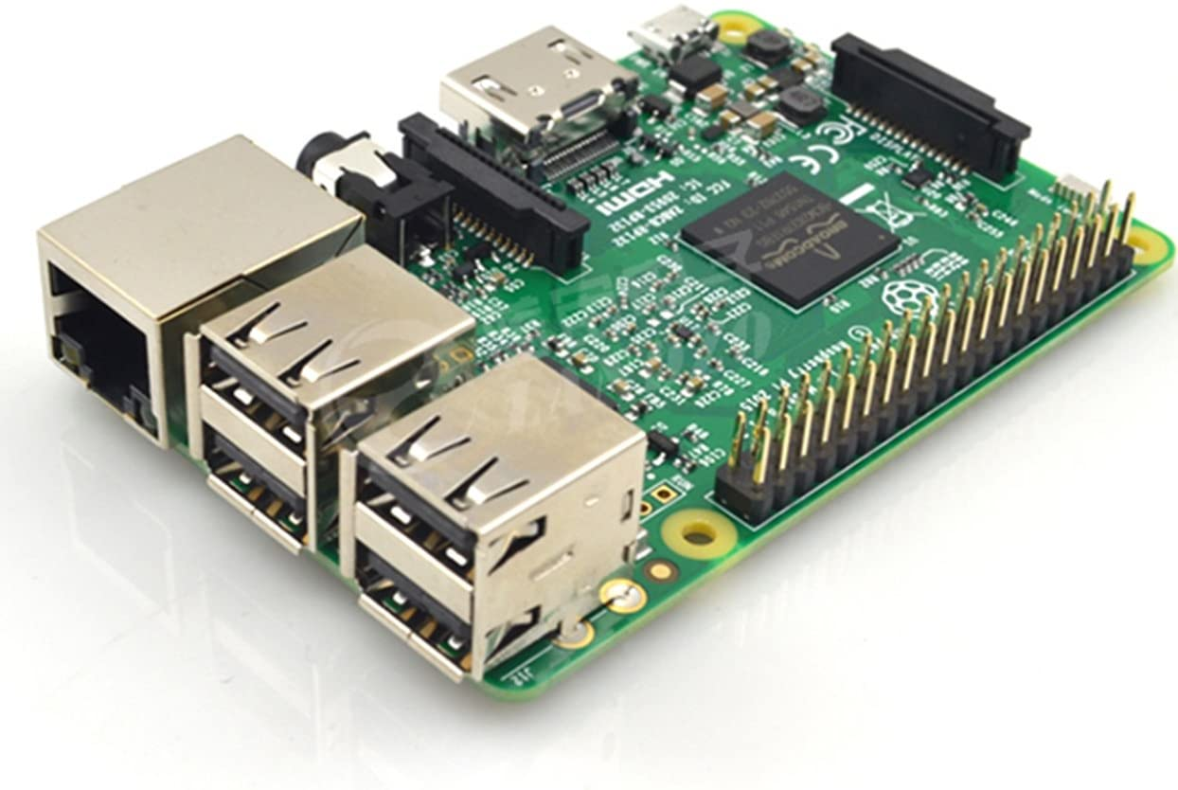
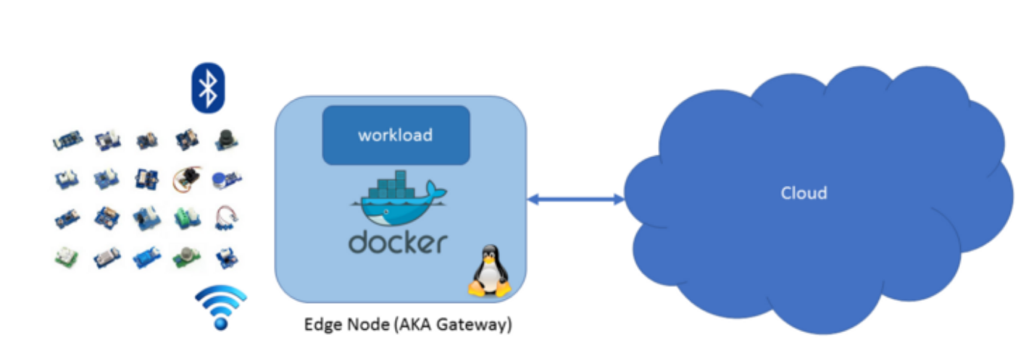
IoT & Serverless
Why Serverless on Edge?
Necessity to process data on Edge nodes.
Edge workloads are event-driven
serverless programming model fits to event-driven applications like a glove

Slide 3



Serverless Frameworks
Microsoft Azure Functions
Amazon Lambda
Apache Openwhisk
Can we use one of those on edge devices?
Big Overhead
Edge devices are resource constrained
Alternative? Try to downsize them

Slide 4
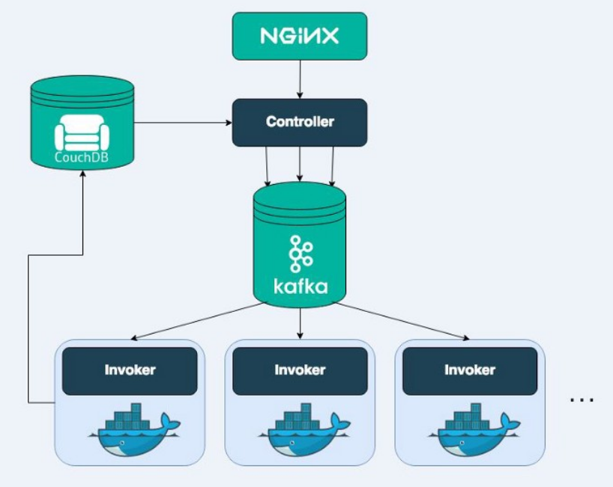
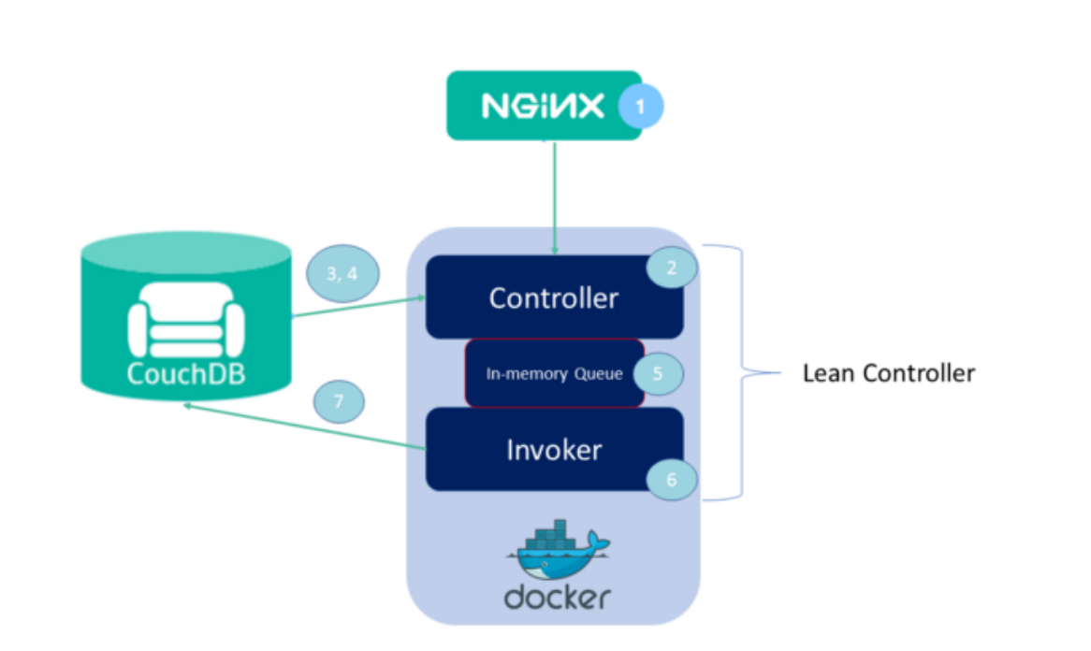
Lean - Openwhisk
Openwhisk
Lean-Openwhisk

Slide 5
The Project
Goals
Install Lean Openwhisk on Raspberry Pi 4
Test our setup with Serverless Benchmarks
Try to see if it is a viable option for a serverless architecture on edge nodes

Slide 6
Project Setup
Step 1 (Install Prerequisites)
Step 3 (Install Lean-Openwhisk)
pip 19.1
ansible 2.7.9
Docker (Fresh install recommended)
Clone github repo of Lean-Openwhisk
Install Lean-Openwhisk using ansible-playbook as shown on github
Step 2 (Pre-Install Configuration)
Step 4 (Install Wsk-Client)
Export needed enviroment variables
Configure the metadata database
pull docker images for nodejs runtime
Download wsk-client from github
Export wsk-cli binary enviroment variable
Update ~/.wskprops file for authentication

Slide 7
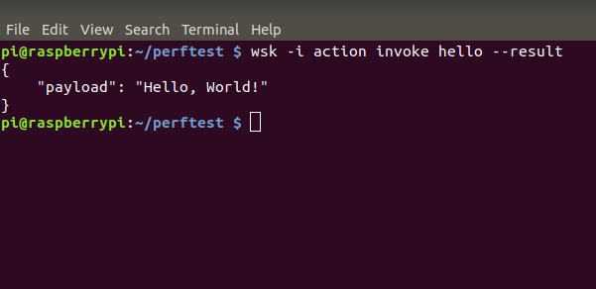
How to use Lean-Openwhisk
Javascript action sample:
/** * Hello world as an OpenWhisk action. */ function main(params) { var name = params.name || 'World'; return {payload: 'Hello, ' + name + '!'}; }
Now create action using wsk-cli:
$wsk action create hello hello.js
Now Invoke the action
$wsk action invoke hello --result

Slide 8

Lean-Openwhisk Experiments
Experiment A : How concurrency affects latency & throughput
Experiment B : How different payloads affects latency & throughput
Experiment C : How transfering different payloads affects latency
For Experiment A,B Lean-Openwhisk-Performance github repo was used ,while for Experiment C ServerlessBench Testcase5 was used

Slide 9

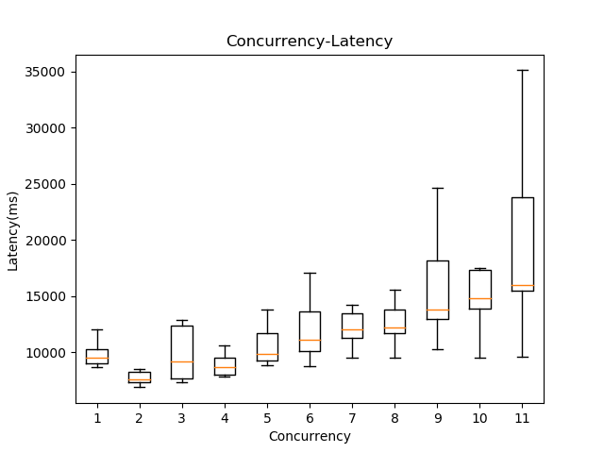
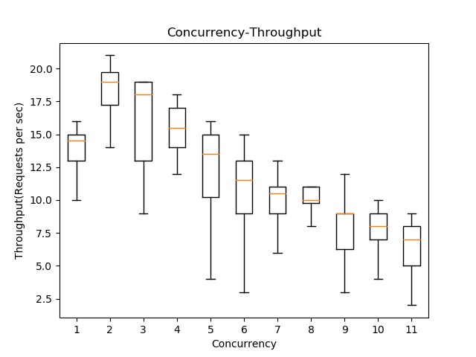
Experiment A

Slide 10
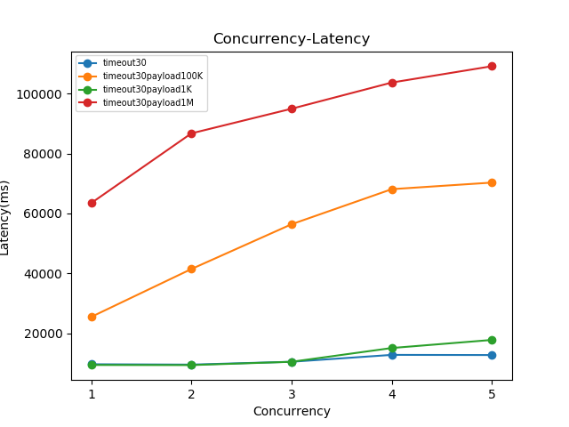
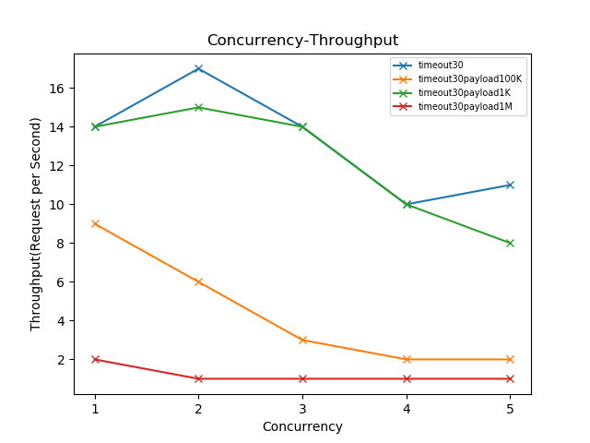
Experiment B

Slide 11
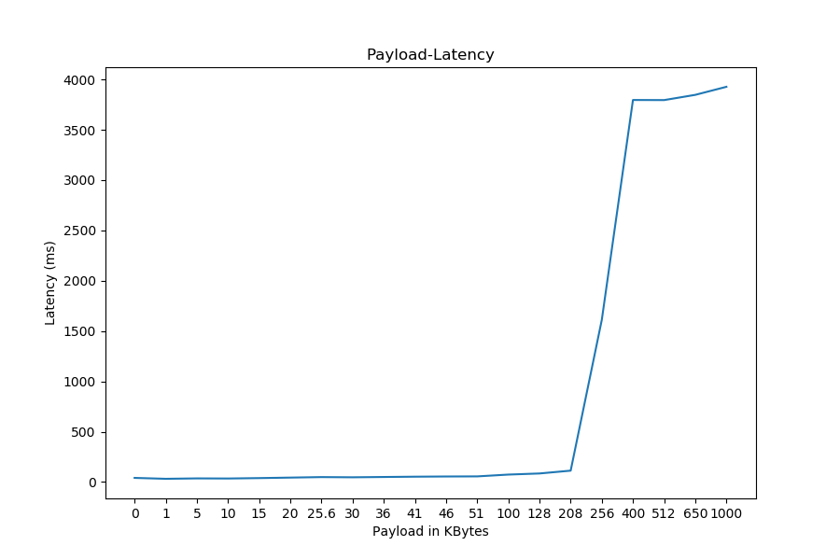
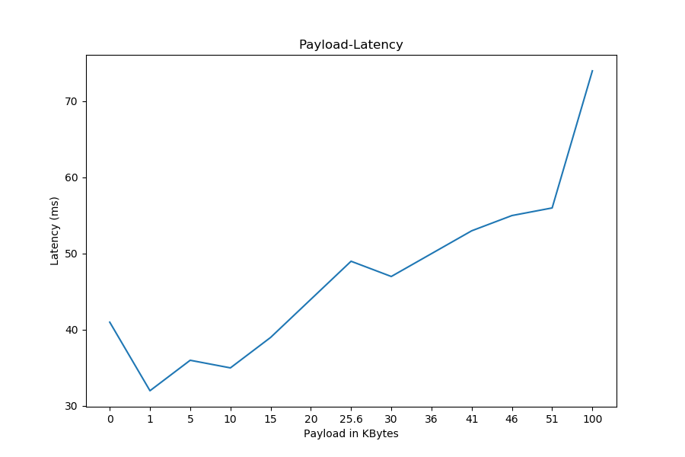
Experiment C

Slide 12
Conclusion
Backend Concurrency is advised to be kept between 1 and 5.Otherwise latency is raised to unwanted levels and throughput plummets
Payloads above 100ΚΒ-200KB are discouraged since latency skyrockets and the achieved throughput gets significantly low
Data transfer for up to 100K doesn't cause significant increase in latency which seems promising for future optimizations in scheduling the functions (maybe partition big ones into smaller?)

Slide 13

Thank you
References:
https://medium.com/openwhisk/lean-openwhisk-open-source-faas-for-edge-computing-fb823c6bbb9b
https://medium.com/openwhisk/apache-openwhisk-meets-raspberry-pi-e346e555b56a
https://github.com/SJTU-IPADS/ServerlessBench
https://github.com/kpavel/lean-openwhisk-performance
https://serverlessbench.systems/socc20-serverlessbench.pdf
Here is a cookie if you got here

